Slide 1

CSC432 – Information Security
Dr. Adnan Ahmad

Slide 2
Basic Concepts

Slide 3
Something to worry about
Trust
An extremely important security concept
You do certain things for those you trust
You don’t do them for those you don’t
Seems simple, ???
Problems with trust
How do you express trust?
Why do you trust something?
How can you be sure who you’re dealing with?
What if trust is situational?
What if trust changes?

Slide 4


Something to worry about
Symmetric Trust
Alice trusts Bob
?

Slide 5
Something to worry about
Transitive Trust
Alice trusts Bob
?
Bob trusts Carol
Carol trusts David

Slide 6
Absolute Security vs Absolute Access
It's very important to understand that in security, one simply cannot say ``what's the best firewall?'‘
There are two extremes: absolute security and absolute access
The closest we can get to an absolutely secure machine is one unplugged from the network, powered off, locked in a safe
Unfortunately, it isn't useful in this state

Slide 7
Absolute Security vs Absolute Access
A machine with absolute access is extremely convenient to use: it's simply there, and will do whatever you tell it, without questions, authorization, passwords, or any other mechanism
Unfortunately, this isn't practical, either
The internet is a bad neighborhood now, and it isn't long before some bonehead will tell the computer to do something like self-destruct, after which, it isn't useful to you

Slide 8
Network Security – First Concepts
Security thus depends on the policies we define and the decisions we take
This is no different from our daily lives
We constantly make decisions about what risks we're willing to accept
When we get in a car and drive to work, there's a certain risk that we're taking
It's possible that something completely out of control will cause us to become part of an accident on the highway
When we get on an airplane, we're accepting the level of risk involved as the price of convenience

Slide 9
Network Security – First Concepts
However, we have a mental picture of what an acceptable risk is, and won't go beyond that in most circumstances
If I happen to be upstairs at home, and want to leave for work, I'm not going to jump out the window
Yes, it would be more convenient, but the risk of injury outweighs the advantage of convenience

Slide 10
Network Security – First Concepts
Every organization needs to decide for itself where between the two extremes of total security and total access they need to be
A policy needs to articulate this, and then define how that will be enforced with practices and such
Everything that is done in the name of security, then, must enforce that policy uniformly

Slide 11
Cost benefit analysis
A database that provides salary information to a second system that print checks.
Huge financial loss
A company has several branch offices and each downloads the database copy daily.
The branch office uses the database to recommend the salary, but the main office use the original database for the final calculations.
Recoverable !

Slide 12
Some Rational Thinking !
Consider a company where 10000 documents are processed per month with no security mechanism.
Security breaches occur about twice per month, and almost 100 documents are compromised per breach. The administrator needs to restart the processing of the breached documents.
Each document’s processing worth about $20, and the documents compromised tend to be about half processed when they are restarted.
If some security mechanism is installed, it will increase the average processing cost about 1% for all the documents.
Should the company install security mechanism?

Slide 13
Key Security Concepts
Security Goals (the CIA triad)
Confidentiality
Integrity
Availability

Slide 14
Key Security Concepts
Confidentiality:
only sender, intended receiver should “understand” message contents
Covers both data confidentiality and privacy
Data confidentiality
Assures that confidential information is not disclosed to unauthorized individuals.
Privacy
Assures that individuals control the information related to them
What may be collected and stored
by whom
To whom that information may be disclosed.

Slide 15
Key Security Concepts
Confidentiality:
Student grade information is an asset whose confidentiality is considered to be highly important by students.
United States – Family Educational Rights and Privacy Act (FERPA)
Grade information (high rating)
Available to students, their parents, and employees that require the information to do their job.
Student enrollment information (moderate rating)
Less likely to be targeted than grade information, and
Results in less damage if disclosed.
Directory information (lists of students/faculty) (low rating)
Typically freely available to the public and published on a school’s Web site.

Slide 16
Key Security Concepts
Integrity:
Sender, receiver want to ensure message not altered (in transit, or afterwards) without detection,
and want to be able to prove that the sender did, in fact, send the message
covers both data and system integrity
Data integrity
Assures that information and programs are changed only in a specified and authorized manner.
System integrity
Assures that a system performs its intended function in an unimpaired (perfect) manner,
free from deliberate or unauthorized manipulation of the system.

Slide 17
Key Security Concepts
Integrity:
Hospital patient’s allergy information database
High requirement for integrity.
The doctor should be able to trust that the information is correct and current.
Inaccurate information could result in serious harm or death to a patient and expose the hospital/doctor to massive liability.
If an employee (e.g., a nurse) authorized to view/update this information deliberately falsifies the data to cause harm to the hospital/patient/doctor.
The database needs to be restored to a trusted basis quickly
it should be possible to trace the error back to the person responsible.

Slide 18
Key Security Concepts
Integrity:
Web site that offers a forum to registered users to discuss some specific topic
Moderate level of integrity
Either a registered user or a hacker could falsify some entries or deface the Web site.
If the forum exists only for the enjoyment of the users,
brings in little or no advertising revenue,
and is not used for something important such as research,
then potential damage is not severe.
The Web master may experience some data, financial, and time loss.

Slide 19
Key Security Concepts
Integrity:
An anonymous online poll
Low integrity requirement
Many Web sites, such as news organizations, offer these polls to their users with very few safeguards.
However, the inaccuracy and unscientific nature of such polls is well understood.

Slide 20
Key Security Concepts
Availability:
Services must be accessible and available to properly authorized users
Ensuring timely and reliable access to and use of information

Slide 21
Key Security Concepts
Availability:
The more critical a component or service, the higher is the level of availability required.
Consider a system that provides authentication services for critical systems, applications, and devices.
An interruption of service results in the inability for customers to access computing resources and staff to access the resources they need to perform critical tasks.
The loss of the service translates into a large financial loss in lost employee productivity and potential customer loss.
Facebook losses $ 24, 420 per minute, if it goes down.

Slide 22
Key Security Concepts
Availability:
Public Web site for a university
moderate availability requirement
The Web site provides information for current and prospective students and donors.
Such a site is not a critical component of the university’s information system, but its unavailability will cause some embarrassment.

Slide 23
Key Security Concepts
Availability:
An online telephone directory lookup application
low availability requirement
Although the temporary loss of the application may be an annoyance,
there are other ways to access the information, such as a hardcopy directory or the operator.

Slide 24
Some additional concepts
Authenticity:
The property of being genuine and being able to be verified and trusted;
Confidence in the validity of a transmission, a message, or message originator.
This means verifying that users are who they say they are and that each input arriving at the system came from a trusted source.
Accountability:
Actions of an entity should be traced uniquely to that entity.
This supports nonrepudiation, fault isolation, intrusion detection and prevention, and after-action recovery and legal action.
Secure systems are not yet an achievable goal, we must be able to trace a security breach to a responsible party.

Slide 25
Key Security Concepts
Types of Attacks
Passive Attack
Make use of information, but not affect system resources, e.g.
Release message contents
Traffic analysis
Relatively hard to detect, but easier to prevent
Active Attack
Alter system resources or operation, e.g.
Masquerade
Replay
Modification
Denial of service
Relatively hard to prevent, but easier to detect

Slide 26
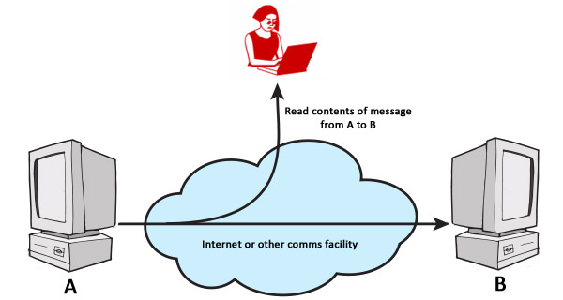
Key Security Concepts
Release message contents – Passive Attack
E

Slide 27
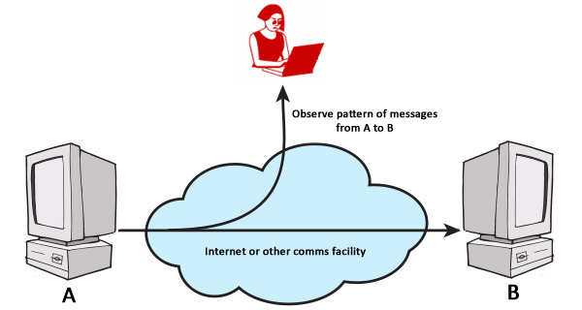
Key Security Concepts
Traffic analysis – Passive Attack
E

Slide 28
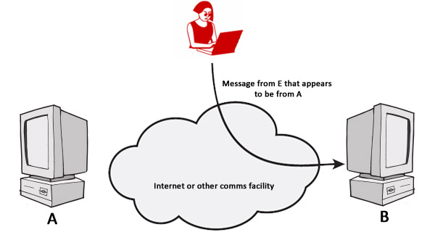
Key Security Concepts
Masquerade – Active Attack
E

Slide 29
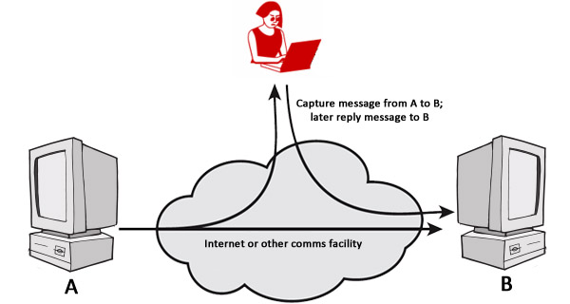
Key Security Concepts
Replay – Active Attack
E

Slide 30
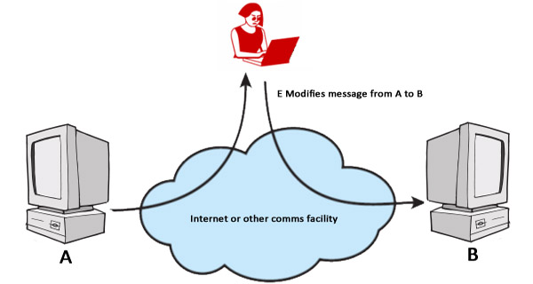
Key Security Concepts
Modification – Active Attack
E

Slide 31
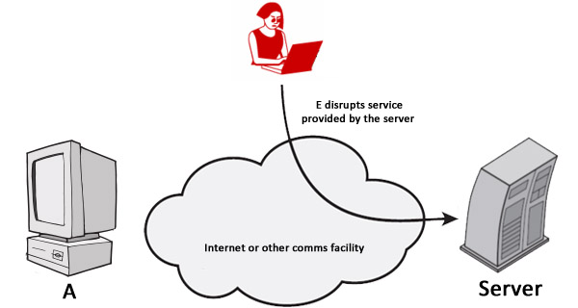
Key Security Concepts
Denial of service – Active Attack
E

Slide 32
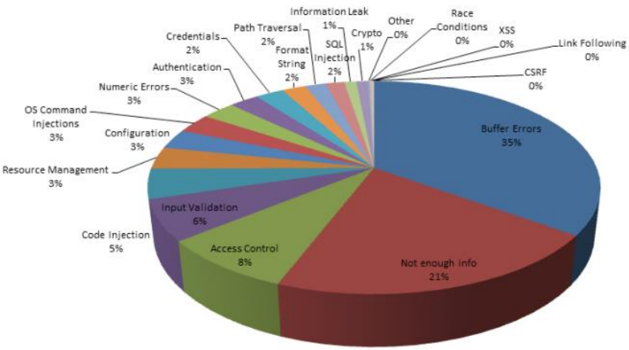
Types of Attacks

Slide 33

Anatomy of a Buffer Overflow
Buffer: memory used to store user input, has fixed maximum size
Buffer overflow: when user input exceeds max buffer size
Extra input goes into memory locations

Slide 34
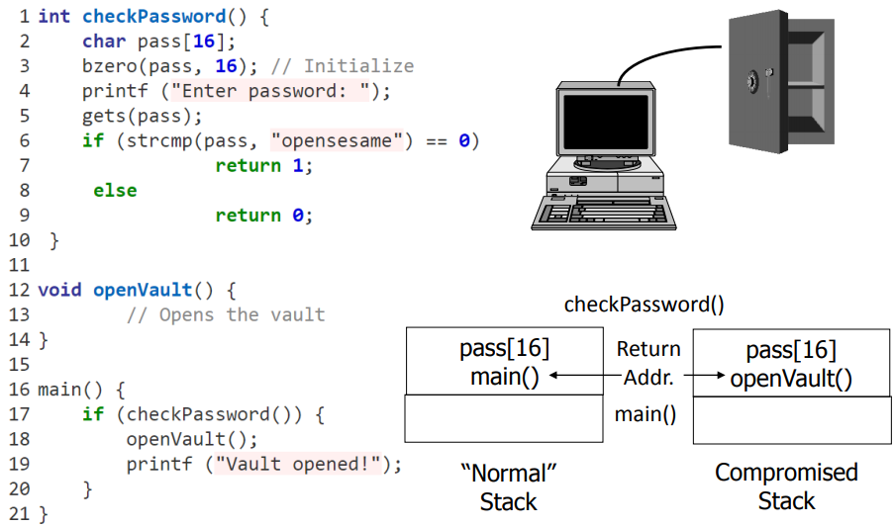
An Example

Slide 35
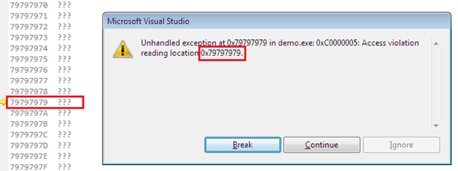
Smashing The Stack For Fun And Profit
http://www-inst.eecs.berkeley.edu/~cs161/fa08/papers/stack_smashing.pdf
https://cs155.stanford.edu/papers/formatstring-1.2.pdf
https://www.checkpoint.com/cyber-hub/cyber-security/what-is-cyber-attack/what-is-a-buffer-overflow/#:~:text=A%20buffer%20overflow%20attack%20is,in%20other%20parts%20of%20memory.

Slide 36
Solution: Defensive Programming
Never Trust Input
Always check buffer lengths
Prevent Errors
Fail Early And Openly
Document Assumptions
Prevention Over Documentation
Automate Everything
Simplify And Clarify
Question Authority
~ Learn C The Hard Way

Slide 37
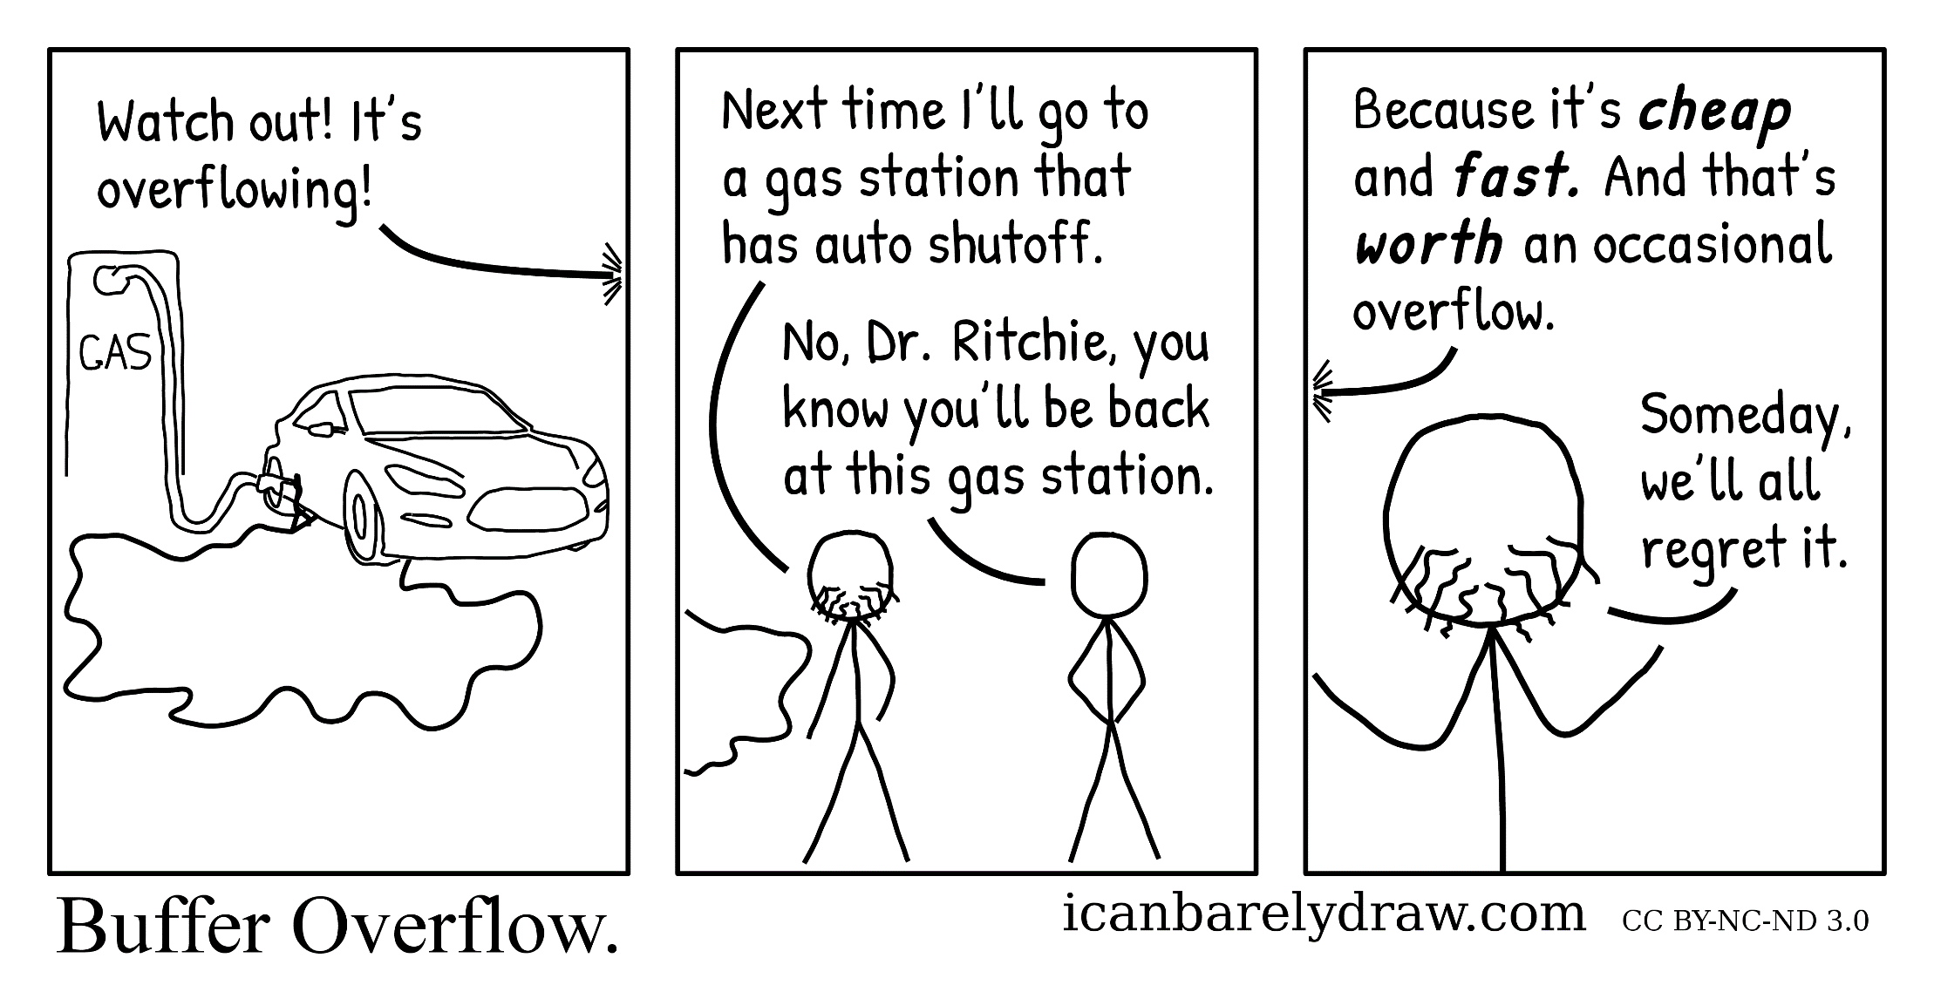
This never happens!

Slide 38
Static Analysis Tools
Static Analysis: analyzing programs without running them
Meta-level compilation
Find security, synchronization, and memory bugs
Detect frequent code patterns/idioms and flag code anomalies that don’t fit
Ex: Coverity, Fortify, Ounce Labs, Klockwork
Coverity found bugs in Linux device drivers
Lots of tools to look for security bugs in Web code

Slide 39
Summary of Buffer overflow
Buffer overflows most common security threat!
Used in many worms such as Morris Worm
Affects both stacks and heaps
Attacker can run desired code, hijack program execution and change its behavior
Prevent by bounds-checking all buffers
And/or use StackGuard, Static Analysis…
Type of Memory Corruption:
Format String Vulnerabilities, Integer Overflow, etc…
Further Reading
“Low-Level Software Security by Example” by Ulfar Erlingsson, Yves Younan, and Frank Piessens

Slide 40
Key Security Concepts
Security Services
Authentication assure that the communicating entity is the one that it claims to be
Access Control prevent unauthorized use of a resource
Data Confidentiality protect data from unauthorized disclosure
Data Integrity assure data received are exactly as sent by authorized entity
Nonrepudiation protect against denial of one entity involved in communications of having participated in communications
Availability system is accessible and usable on demand by authorized users according to intended goal

Slide 41



Key Security Concepts
Alice and Bob are the two most famous persons in network security
They are used everywhere
Alice and Bob want to communicate “securely”
Trudy (intruder) may interrupt, intercept, modify, fabricate and so on, to disrupt their communications

Slide 42
Key Security Concepts
Who might Alice and Bob be?
Well, real-life Alice(s) and Bob(s)!
Web browser/server for electronic transactions (e.g., on-line purchases)
On-line banking client/server
DNS servers
Routers exchanging routing table updates
Other examples?

Slide 43
Key Security Concepts
Question: What could Trudy do in this case?
Answer: Unfortunately, a lot!
Interruption: Somehow disrupt the service being provided by the network to Alice and Bob
Interception: Eavesdrop on communication meant to be private or confidential
Modification: Tamper with information or network resources
Fabrication: Counterfeit information or network resources or services are inserted into the network

Slide 44
Key Security Concepts
How can we protect ourselves from these attacks?
Interruption attacks:
Firewalls, replication, backups, hardware appliances
Interception attacks:
Encryption, traffic padding
Modification attacks:
Encryption, traffic padding, backups, messaging techniques (checksums, sequence numbers, digests, authentication codes)
Fabrication attacks:
Authentication and authorization, firewalls, digital signatures

Slide 45
Key Security Concepts
Security is a policy, Protection is a mechanism
Protection mechanisms implement security policies
Vulnerability is a weakness that can allow an attacker to cause problems
Exploit is an actual incident of taking advantage of a vulnerability

Slide 46
Key Security Concepts
Virus is a potentially damaging computer program (code), can spread and damage files. It attaches itself to programs, disks, or memory to propagate itself
Worm copies itself repeatedly, using up resources and possibly shutting down computer or network
Trojan horse hides within or looks like legitimate program until triggered, does not replicate itself on other computers
Spyware is program placed on computer without user’s knowledge, collects personal information
Adware is a program that displays online advertisements
Spam is unsolicited e-mail message sent to many recipients

Slide 47
Key Security Concepts
Hoax uses emotion to propagate, e.g., child's last wish
Trap door is an undocumented entry point for debugging purposes
Logic bomb are instructions that trigger on some event in the future
Zombie are malicious instructions that can be triggered remotely
Phishing is a scam in which a perpetrator sends an official looking e-mail that attempts to obtain your personal information

Slide 48
THANKS

